Slide 1
ZINNOVATIA 3.0
Sprout7 AgriTech Transformation
Zinnovatio 3.0 – Agriculture & Rural Development
Tagline: “Smart Farming. Stronger Rural Economy.”
TEAM: SPROUT 7
TEAM LEADER - HARSH PANDEY [BTECH CSE DS+AI 2ND Y]
TEAM MEMBER- MADHUR SHUKLA [BTECH CSE DS+AI 2ND Y]
TEAM MEMBER- SURAJ DUBEY [BTECH CSE DS+AI 2ND Y]
TEAM MEMBER- AIMEN ABIDI [BTECH CSE ML+AI 2ND Y]
TEAM MEMBER- ABHIGYAN SRIVASTAVA [BTECH CSE DS+AI 2ND Y]

Slide 2
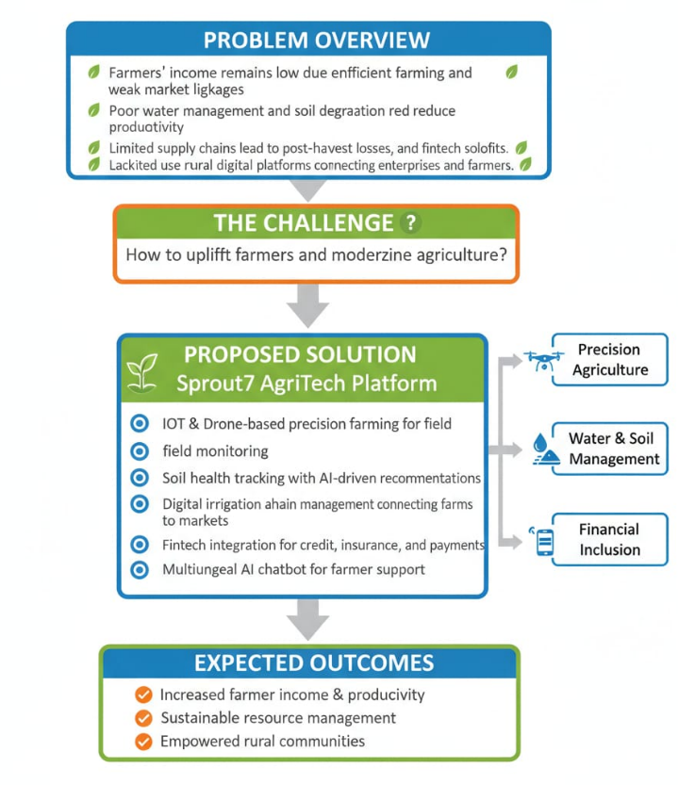
Problem Overview
• Farmers income remains low due to inefficient farming and weak market linkages.
• Poor water management and soil degradation reduce productivity.
• Weak supply chains lead to post-harvest losses and low profits.
• Limited use of precision agriculture, drones, and fine tech solutions.
• Lack of rural digital platforms connecting enterprises and farmers
Proposed Solution: Sprout7 AgriTech Platform
• IoT & Drone-based precision farming for field monitoring.
• Soil health tracking with AI-driven recommendations.
• Smart irrigation and water analytics.
• Digital supply-chain management connecting farms to markets.
• Fintech integration for credit, insurance, and payments.
• Multilingual AI chatbot for farmer support.

Slide 3
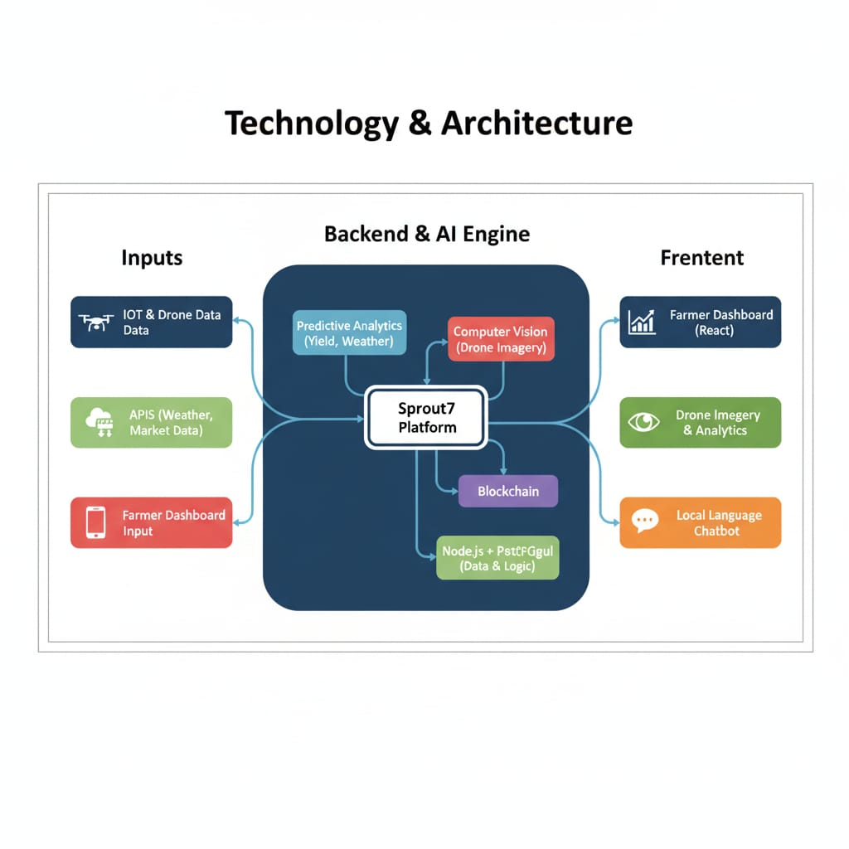
Technical Approach
Frontend:
• Farmer dashboard (React) – crops, alerts, finances.
• Drone imagery and analytics dashboard.
• Local language chatbot (text/voice).
Backend & AI Engine:
• Predictive analytics for yield, weather, and irrigation (Python). • Computer vision for drone imagery analysis.
• Blockchain for transparent supply-chain tracking.
• Node.js + PostgreSQL for secure, scalable architecture
Integrated Systems:
• APIs: weather, soil, market data.
• IoT + Drone data fusion.
• Fintech API for transactions and risk scoring

Slide 4
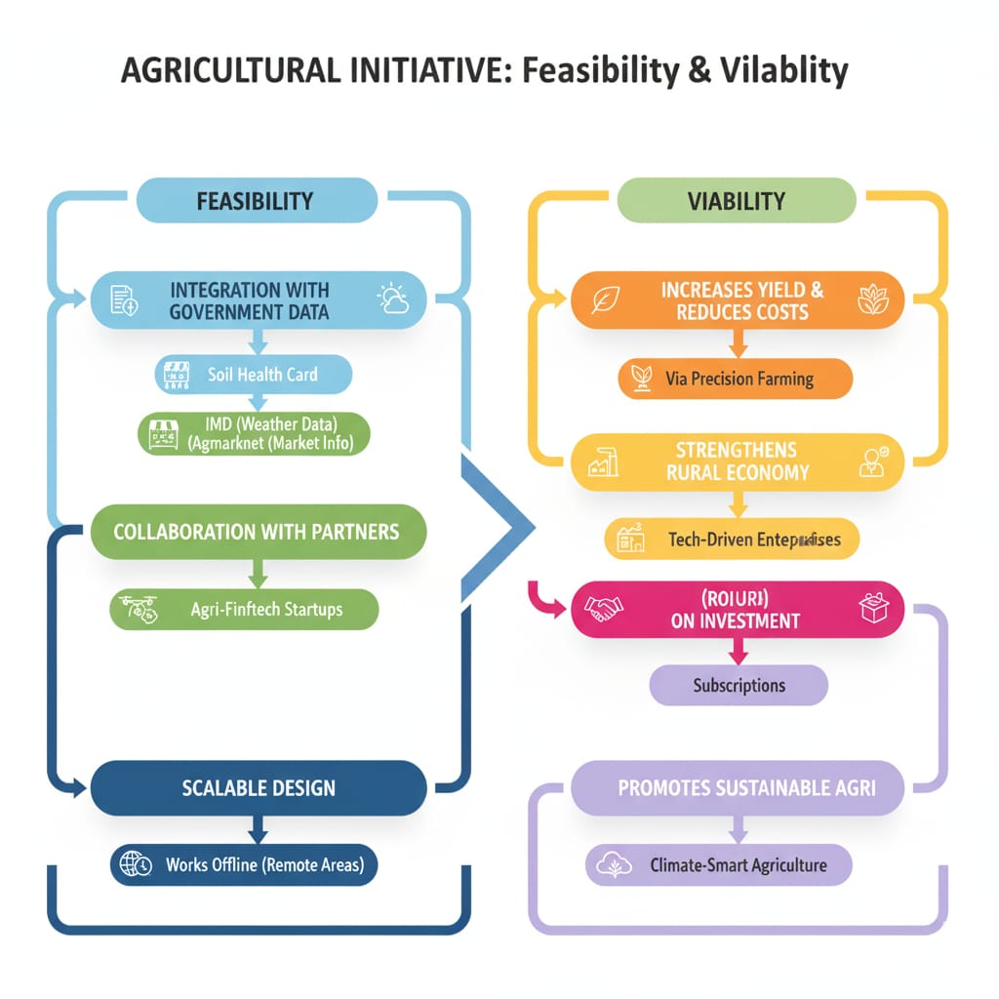
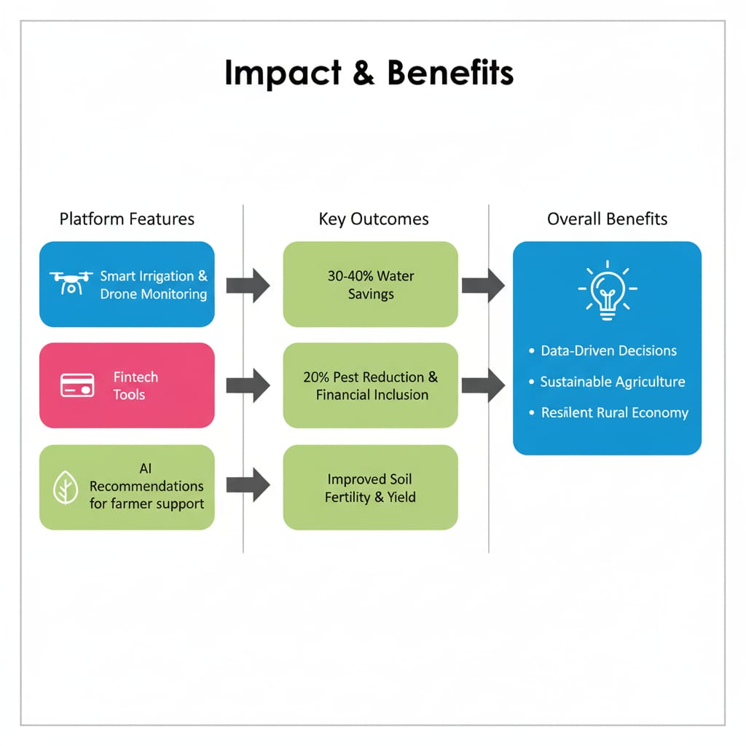
Feasibility:
• Integration with government data (Soil Health Card, IMD, Ag-market).
• Collaboration with drone service providers and agri-fintech startups.
• Scalable design works offline for remote areas.
Viability:
• Increases yield and reduces input costs via precision farming.
• Strengthens rural economy through tech-driven enterprises.
• ROI through public-private partnerships and subscriptions.
• Promotes sustainable, climate-smart agriculture.
Impact:
• 30–40% water savings via smart irrigation.
• 20% reduction in pest-related losses with drone monitoring.
• Improved soil fertility and reduced chemical usage.
• Greater financial inclusion through digital tools.
• Creates rural employment in drone and data services.
Benefits:
• Data-driven decisions for farmers.
• Efficient supply chains and transparent transactions.
• Sustainable agricultural practices.
• Inspires youth to adopt modern farming.
• Builds a strong, resilient rural economy.

Slide 5

Research & References
• Soil Health Card Portal – https://soilhealth.dac.gov.in/
• Ag-market – https://agmarknet.gov.in/
• Open Weather API – https://openweathermap.org/api
• Drone Policy 2021 – Ministry of Civil Aviation
• NABARD Fintech Innovation Reports
• Kerala Agricultural University (KAU)Kerala Agricultural University (KAU) is a State Agricultural University in Kerala, India. Wikipedia+2Kerala Agricultural University+2
It was established under the Agricultural University Act, 1971 (Act 33 of 1971), on 24 February 1971, but became operational from 1 February 1972.

